Slide 1
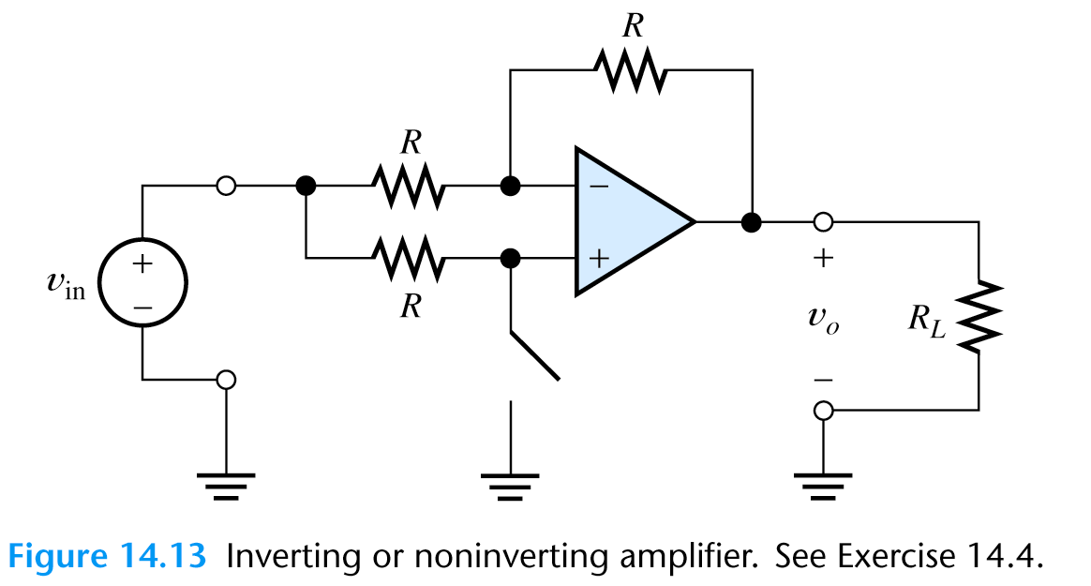
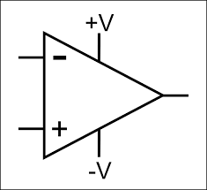
Operational Amplifiers

Slide 2
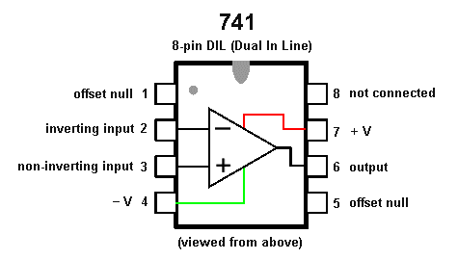
Operational amplifiers (op-amps)
741 Amplifier is the most popular amplifier it has
A_{vo}=100000 (voltage gain without load)

Slide 3
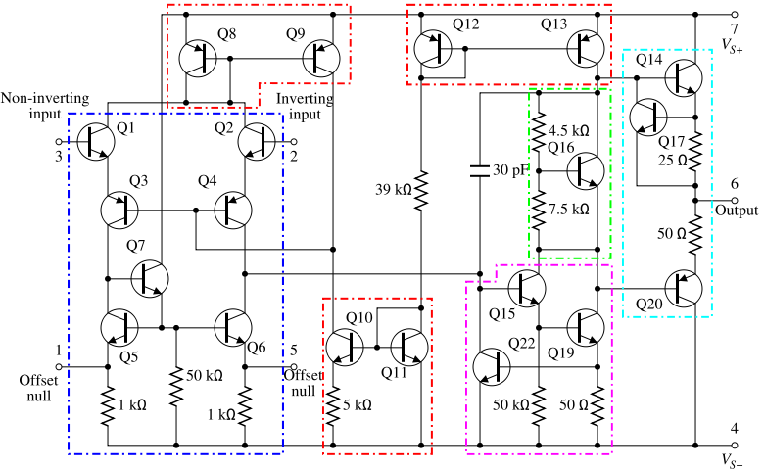
Operational amplifiers (op-amps)
741 Amplifier BJT transistor level schematic

Slide 4
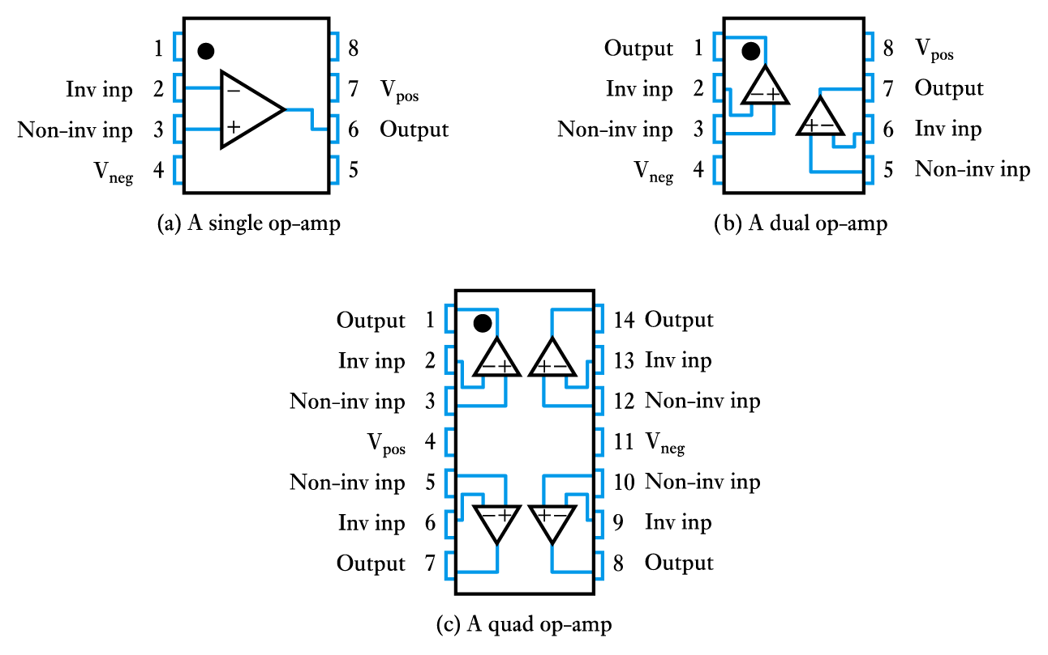
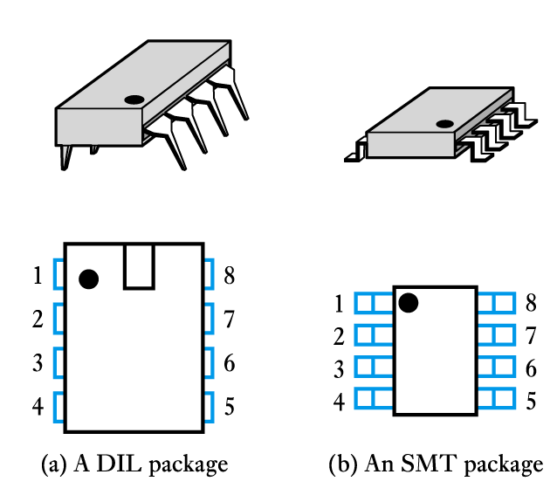
Operational amplifiers (op-amps) are among the most widely used integrated circuits (ICs) in electronics.
A single package will often contain several op-amps

Slide 5
Operational Amplifier Model
An operational amplifier circuit is designed so that
V_{out} = A (V₁-V₂) (A is a very large gain)
Input resistance (R_{in}) is very large
Output resistance (R_{out}) is very low
V₁
R_{out}
V_{out}
R_{in}
+
A (V₁- V₂)
-
V₂

Slide 6
Typical Op Amp Parameters
Parameter | Variable | Typical Ranges | Ideal Values
Open-Loop Voltage Gain | A | 10⁵ to 10⁸ | ∞
Input Resistance | R_{i} | 10⁵ to 10¹³ Ω | ∞ Ω
Output Resistance | R_{o} | 10 to 100 Ω | 0 Ω
Supply Voltage | Vcc/V⁺ -Vcc/V⁻ | 5 to 30 V -30V to 0V | N/A N/A

Slide 7
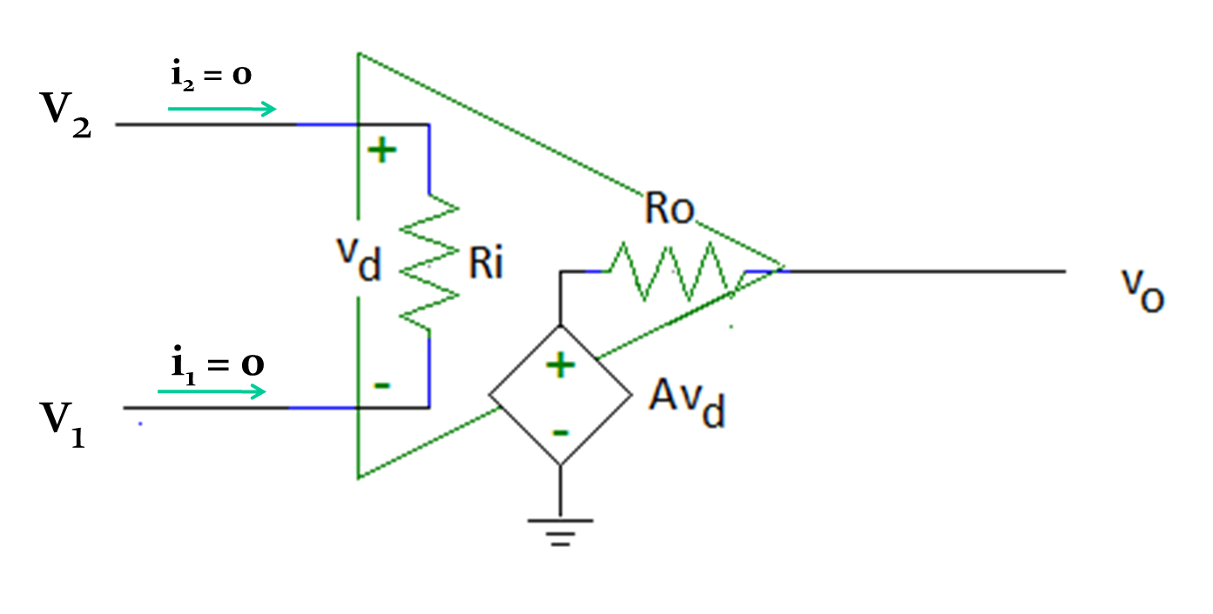
An Ideal Operational Amplifier
R_{i} = ∞
Therefore, i₁ = i₂ = 0A
R_{o} = 0

Slide 8
An Ideal Operational Amplifier

Slide 9
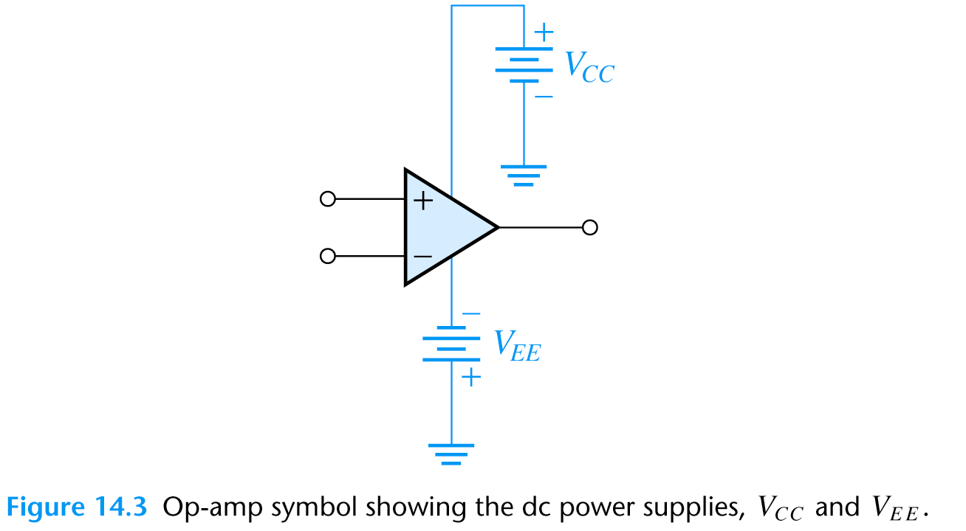
An Ideal Operational Amplifier
A real op-amp must have a DC supply voltage which is often not shown on the schematics.

Slide 10

Op-amps
Output voltage of an Op-amp can not be greater than DC supply voltage.
Maximum output voltage is usually slightly lower than the DC supply voltage and called as saturation voltage.

Slide 11
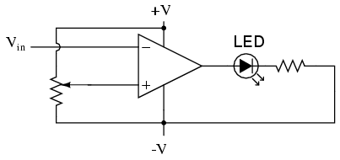
Comparator
V₁
V_{out}
V₂
Applications: Low-voltage alarms, night light controller

Slide 12
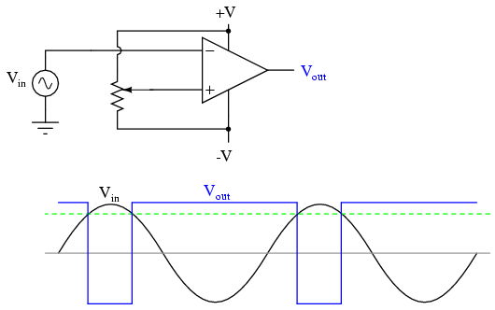
Pulse Width Modulator
Output changes when V_{in} ~= V_{pot}
V_{pot}
+V_{sat}
V_{pot}
-V_{sat}
Application: Motor controllers

Slide 13
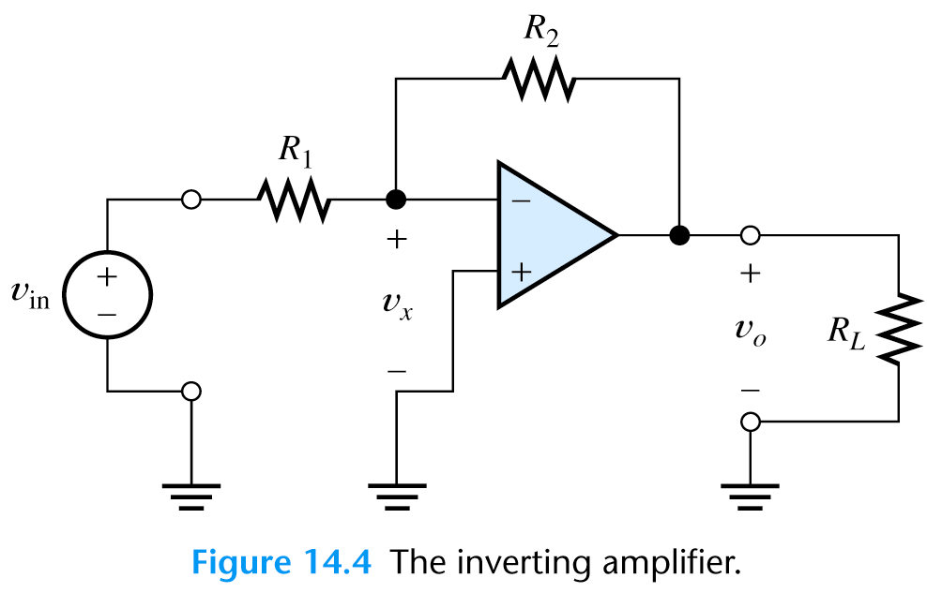
Negative feedback
Op-amp are almost always used with a negative feedback:
Part of the output signal is returned to the input.
Feedback reduces the gain of op-amp.
Negative feedback forces the voltage at the inverting input terminal to be equal to the voltage at the noninverting input terminal.
i₂
i₁

Slide 14
When A is very large:
Take A=10⁶, R₁=9R, R₂=R
Gain now determined only by resistance ratio
Doesn't depend on A (or temperature, frequency, variations in fabrication).

Slide 15
Why use Negative feedback?:
Makes properties predictable - independent of temperature, manufacturing differences or other properties of the opamp.
Circuit properties only depend upon the external feedback network and so can be easily controlled.

Slide 16
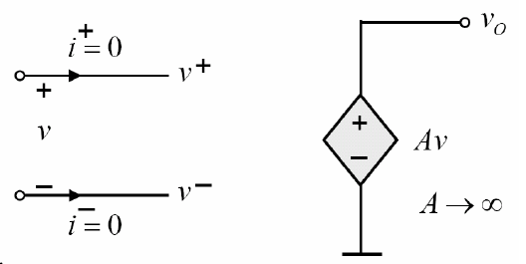
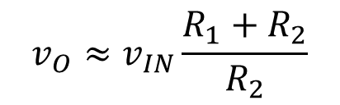
More insight (Under negative feedback)
$$v_{O}≈v_{IN}\frac{R_{1}+R_{2}}{R_{2}}$$
We also know
i⁺ ≈ 0
i⁻ ≈ 0
Helpful for analysis (under negative feedback)
Two "Golden Rules«
1) No current flows into the op-amp
2) v⁺ ≈ v⁻

Slide 17
Inverting Amplifier
Since negative feedback forces the voltage at the inverting input terminal (v₋) to be equal to the voltage at the noninverting input terminal (v₊), v_{x} is equal to zero.
v₋= v₊=0V
i₁ = v_{in} /R₁
i₂ = i₁ and
v_{o} = -i₂ R₂ = -v_{in} R₂ /R₁
So
A_{v}=v_{o} /v_{in} =-R₂ /R₁
i₂
i₁

Slide 18
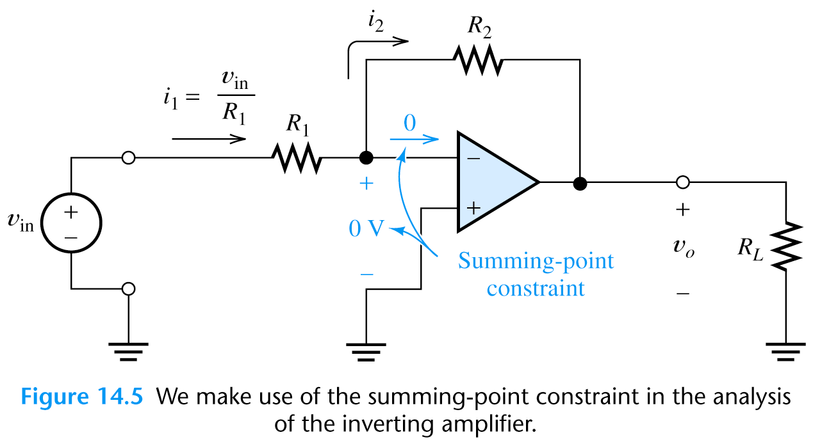
Inverting Amplifier
Since v_{o} = -i₂ R₂ = -v_{in} R₂ /R₁
We see that the output voltage does not depend on the load resistance.
The output impedance of the inverting amplifier is zero.
The input impedance is: Z_{in}=v_{in}/i₁=R₁
Z_{in}
Z₀

Slide 19
Summing Amplifier
The output voltage in summing amplifier is
v_{out}=i_{f}*R_{f} since v₋=v₊=0

Slide 20
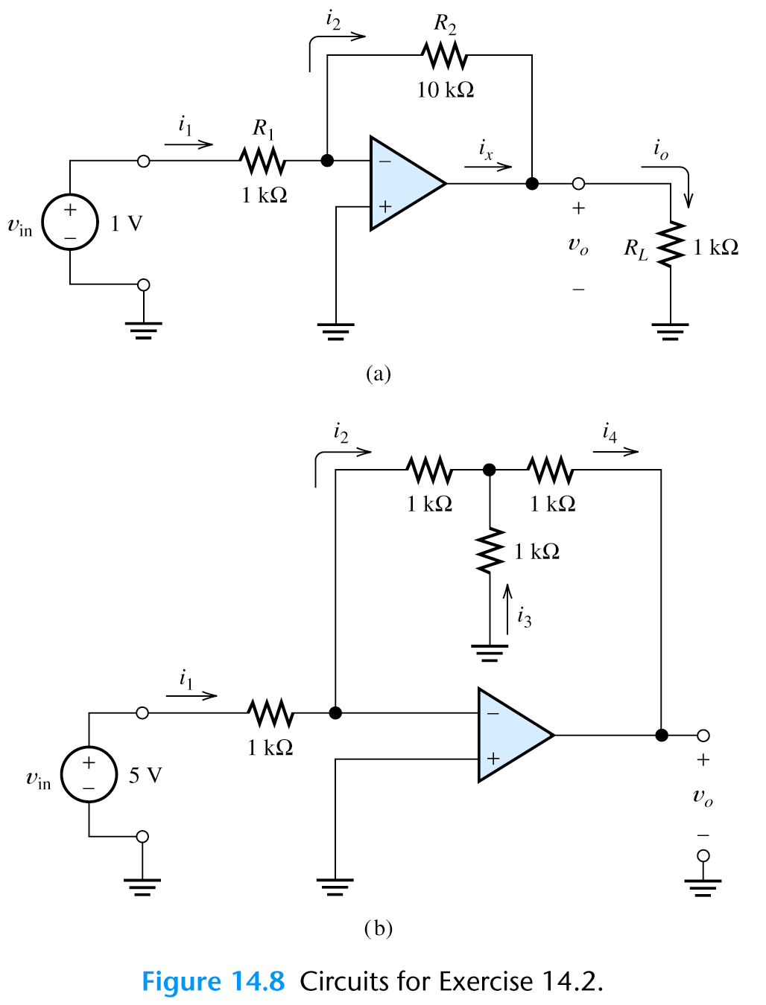
Exercise
Find the currents and voltages in these two circuits:
a) i₁=v_{in}/R₁=1V/1k Ω =1mA
i₂=i₁=1mA from KCL
v_{o}=-i₂*R₂=-10V from KVL
i_{o}=v_{o}/R_{L}=-10mA from Ohms law
i_{x}=i_{o}-i₂=-10mA-1mA=-11mA
b) i₁=v_{in}/R₁=5mA
i₂=i₁=5mA
i₂*1kΩ= i₃*1kΩ => i₃=5mA
i₄=i₂+i₃=10mA
v_{o}=- i₂*1k Ω - i₄*1k Ω =-15 V
R₁

Slide 21
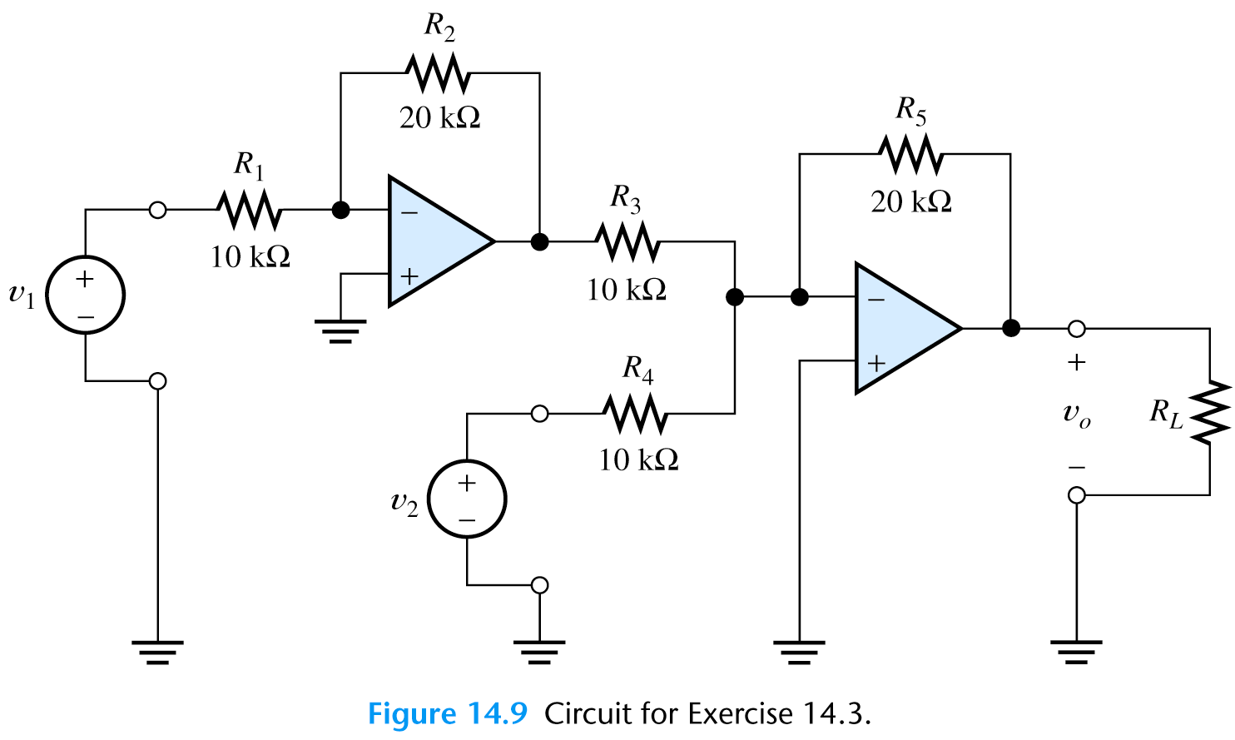
Exercise
Find expression for the output voltage in the amplifier circuit:
i₂
i₅
i₁
V₃
i₃
i_{L}
i₄
i₁=v₁/R₁=v₁/10k Ω
i₂=i₁=v₁/10mA
v₃ =- i₂*R₂=- v₁/10k Ω *20k Ω =-2v₁
i₅=i₃+i₄=v₃/10k Ω +v₂/10k Ω
v_{o} =- i₅*R₅=-(v₃/10k Ω +v₂/10k Ω )*20k Ω =-2v₃ -2v₂ =4v₁ -2v₂

Slide 22
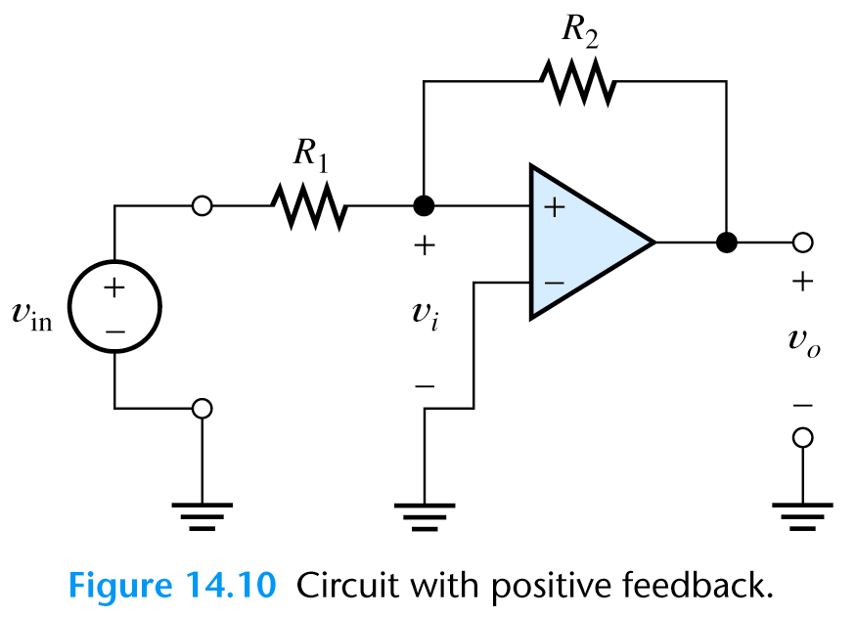
Positive Feedback
When we flip the polarization of the op-amp as shown on the figure we will get a positive feedback that saturates the amplifier output.
This is not a good idea.

Slide 23
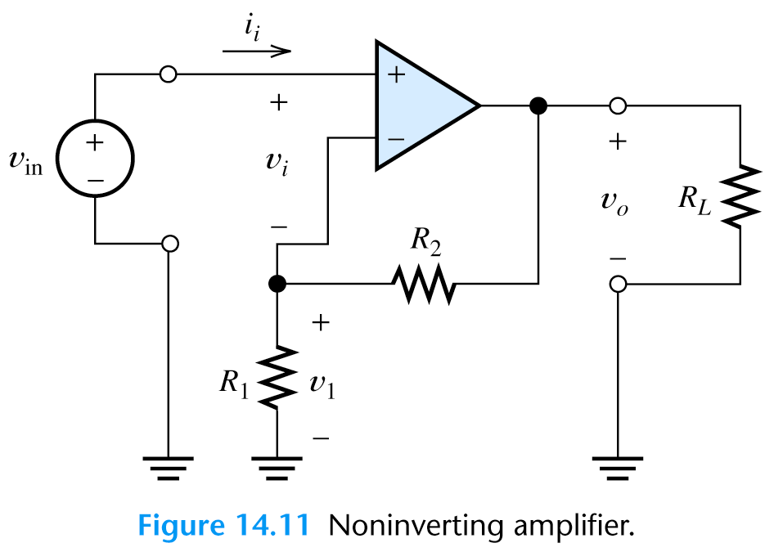
Noninverting Amplifier
v₁=v_{in}
v_{in}/R₁ +(v_{in}- v_{o})/R₂=0
Thus the voltage gain of noninverting amplifier is:
A_{v}= v_{o} /v_{in} = 1+ R₂ /R₁
i_{L}
-i₁
i₂

Slide 24
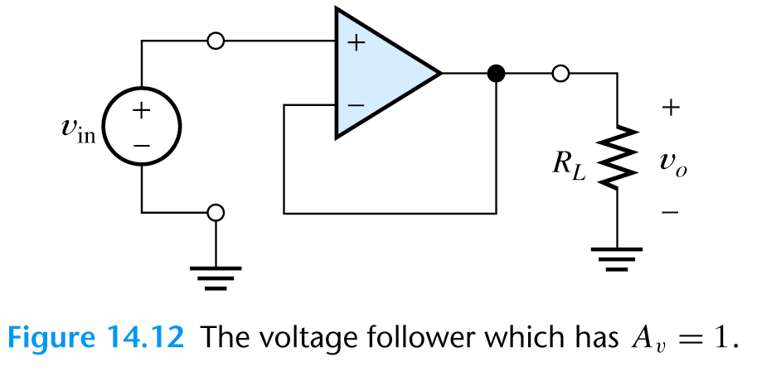
Voltage Follower
What's the application of this circuit?
Buffer
voltage gain = 1
input impedance=∞
output impedance=0
Useful interface between different circuits:
Has minimum effect on previous and next circuit in signal chain

Slide 25
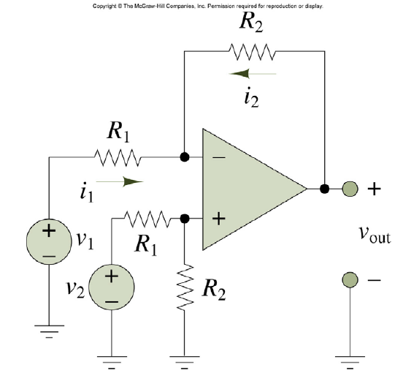
Differential Amplifier (subtractor)

Slide 26
Exercise
Find voltage gain A_{v}=v_{o}/v_{in} and input impedance
With the switch open
With the switch closed
i₁
i₁
i₂
a. With the switch open
i₂=0 and i₁*R=i₂*R => i₁=0
so v_{in}=v_{o} and A_{v}=v_{o}/v_{in} =1
Input impedance:
Z_{in}=v_{in}/i_{in} =v_{in}/0 =inf

Slide 27
Exercise
Find voltage gain A_{v}=v_{o}/v_{in} and input impedance
With the switch open
With the switch closed
b. for closed switch: i₂=v_{in}/R
and i₁*R=i₂*R => i₁=i₂ => v_{in}=i₁*R+i₁*R+v_{o}
so v_{in}=v_{in}/R*R+v_{in}/R*R+v_{o} => -v_{in}=v_{o}
and A_{v}=v_{o}/v_{in} =-1
i₁
i₁
i₂

Slide 28
Exercise
Find voltage gain A_{v}=v_{o}/v_{in} and input impedance
With the switch open
With the switch closed
b. i₂=v_{in}/R
Input impedance: Z_{in}=v_{in}/i_{in} =v_{in}/(i₁+i₂)
and i₁=i₂ =>
Z_{in}=v_{in}/i_{in} =v_{in}/(2*v_{in}/R)=R/2
i₁
i₁
i₂

Slide 29
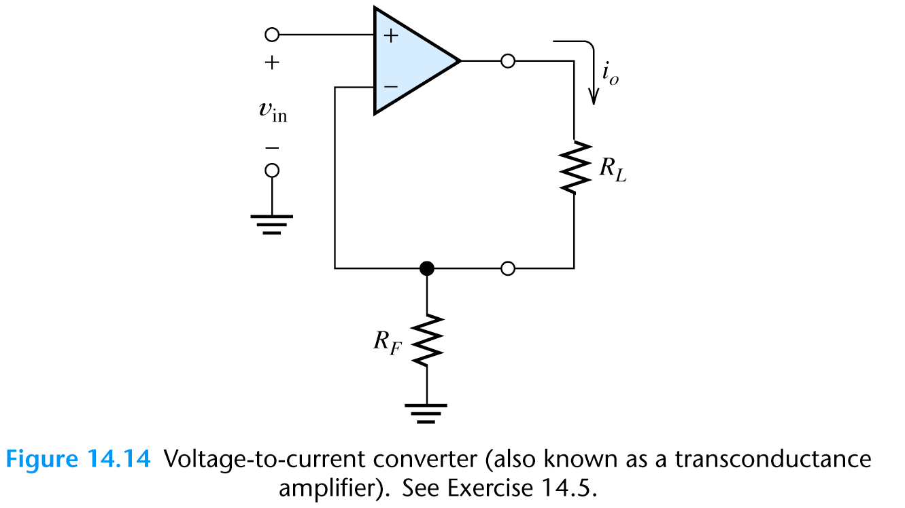
Voltage to Current Converter
Find the output current i_{o} as a function of v_{in}
v_{in} =i_{o}*R_{f}
so
i_{o}=v_{in}/R_{f}

Slide 30
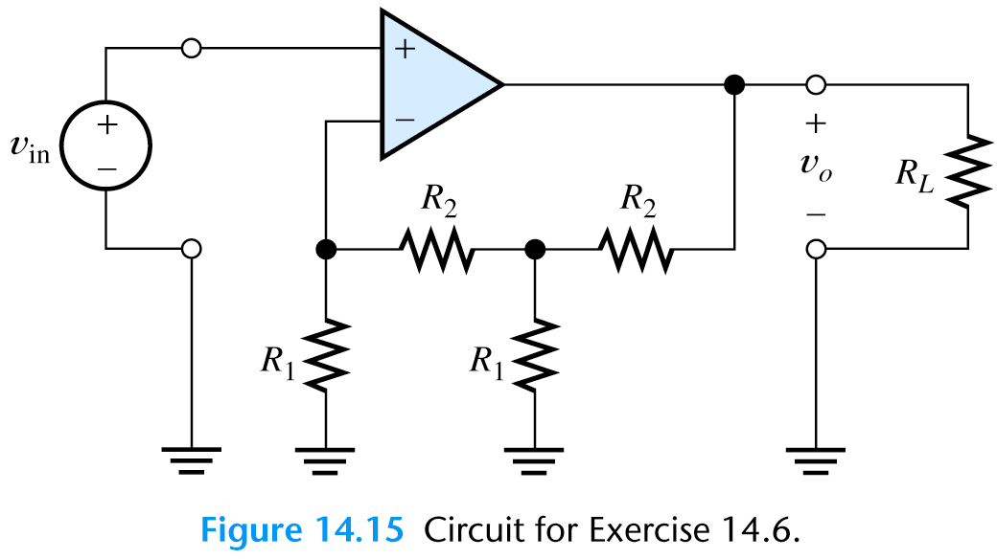
Exercise
Calculate the voltage gain v_{o}/v_{in} for R₁=10 kΩ, R₂ = 100 kΩ
Find the input resistance

Slide 31
Exercise
Calculate the voltage gain v_{o}/v_{in} for R₁=10kΩ, R₂ = 100 kΩ
Find the input resistance
From KCL1: v_{in}/R₁ +(v_{in}-v₂)/R₂=0 => v₂= v_{in} (1+ R₂ /R₁)=11v_{in}
From KCL2: (v₂-v_{in})/ R₂ +v₂/R₁+(v₂-v₀)/ R₂ =0 =>
v₀=(v₂-v_{in}) +v₂R₂/R₁+v₂ =>
v₀ / v_{in} =131
v₂

Slide 32
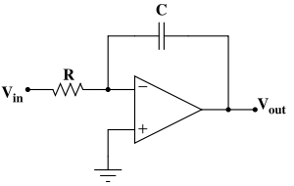

Op-amp integrator
V
V_{IN}
Integrator response to a constant voltage:
t
V_{OUT}
V
V_{IN}
What's the integrator response to a square wave?
t
V_{OUT}

Slide 33
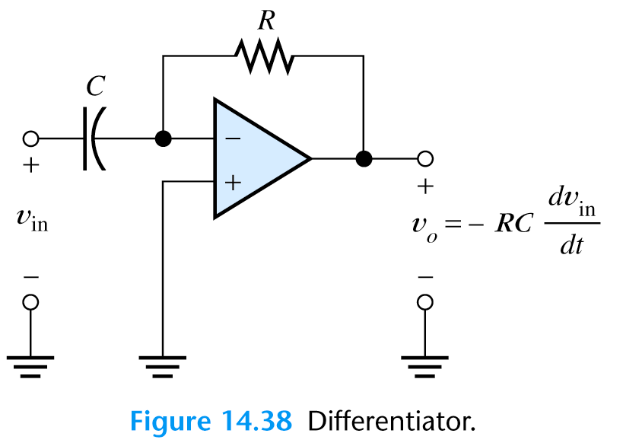
Differentiating Op-Amp

Slide 34
Op-Amp Imperfections in a Linear Mode
We consider the following op-amp imperfections:
Input and output impedances:
Ideal opamp
Real op-amp has

Slide 35
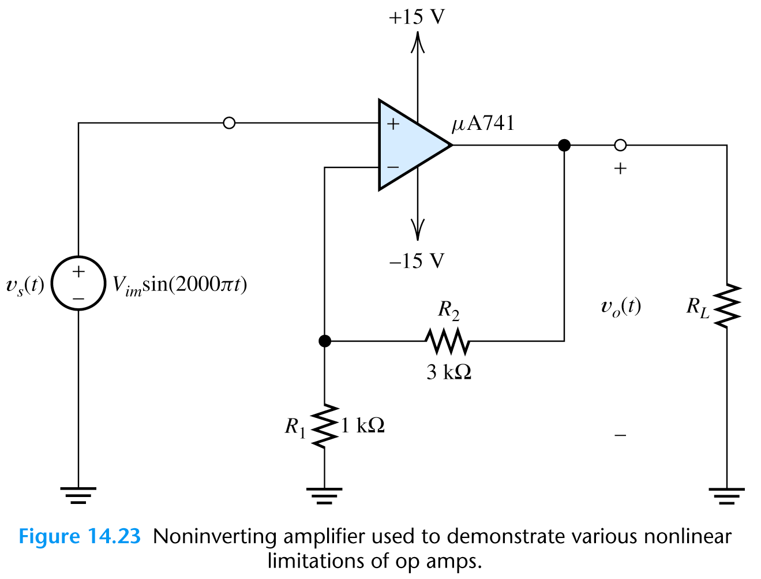
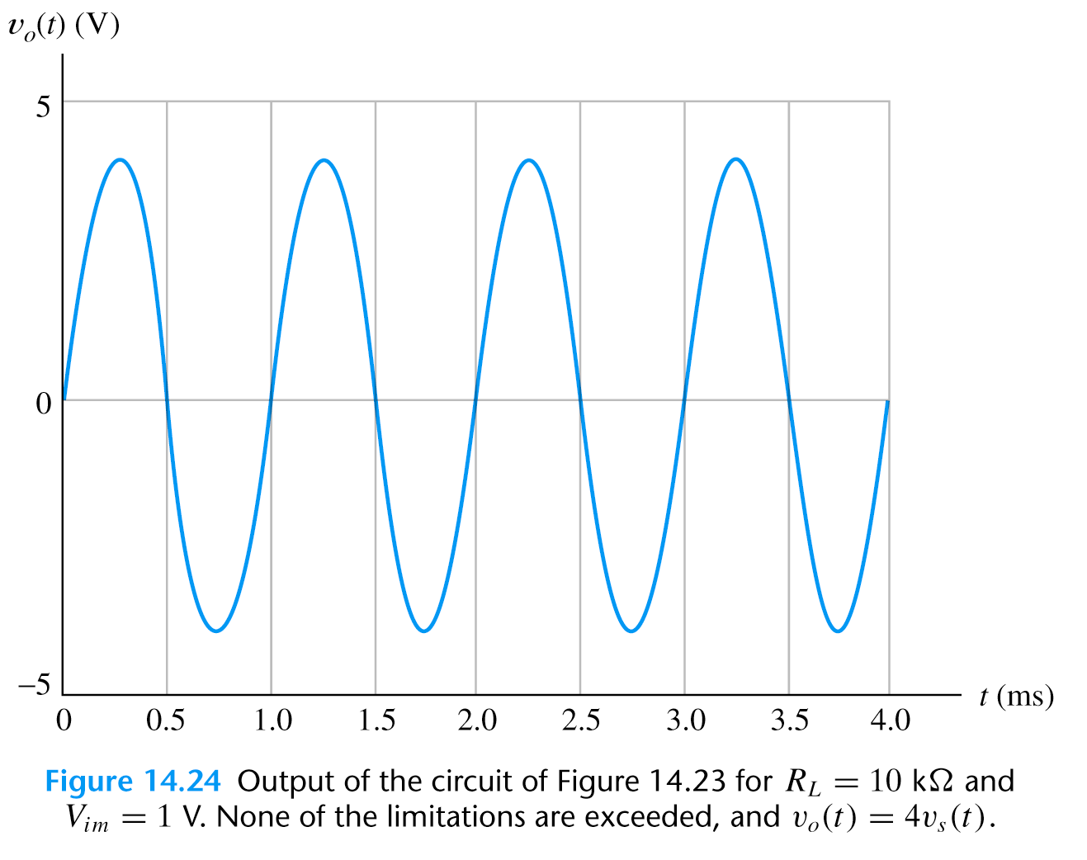
Nonlinear Limitations
Nonlinear limitations:
Output voltage swing is limited and depend on power supply voltage for
Maximum output current is limited

Slide 36
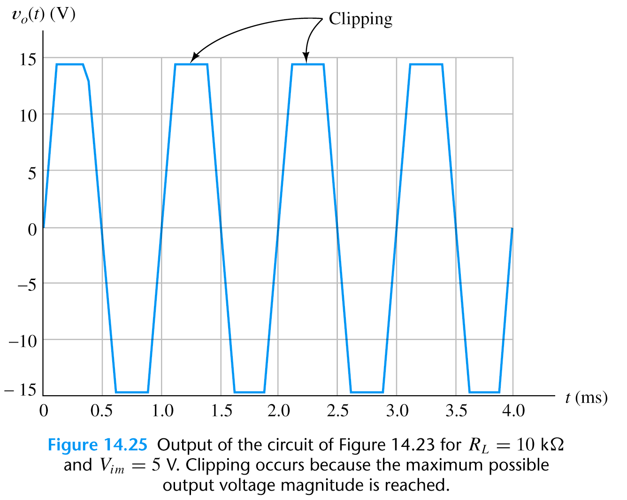
Nonlinear Limitations
When voltage or current limits are exceeded, clipping of the output signal occurs causing large nonlinear distortions

Slide 37
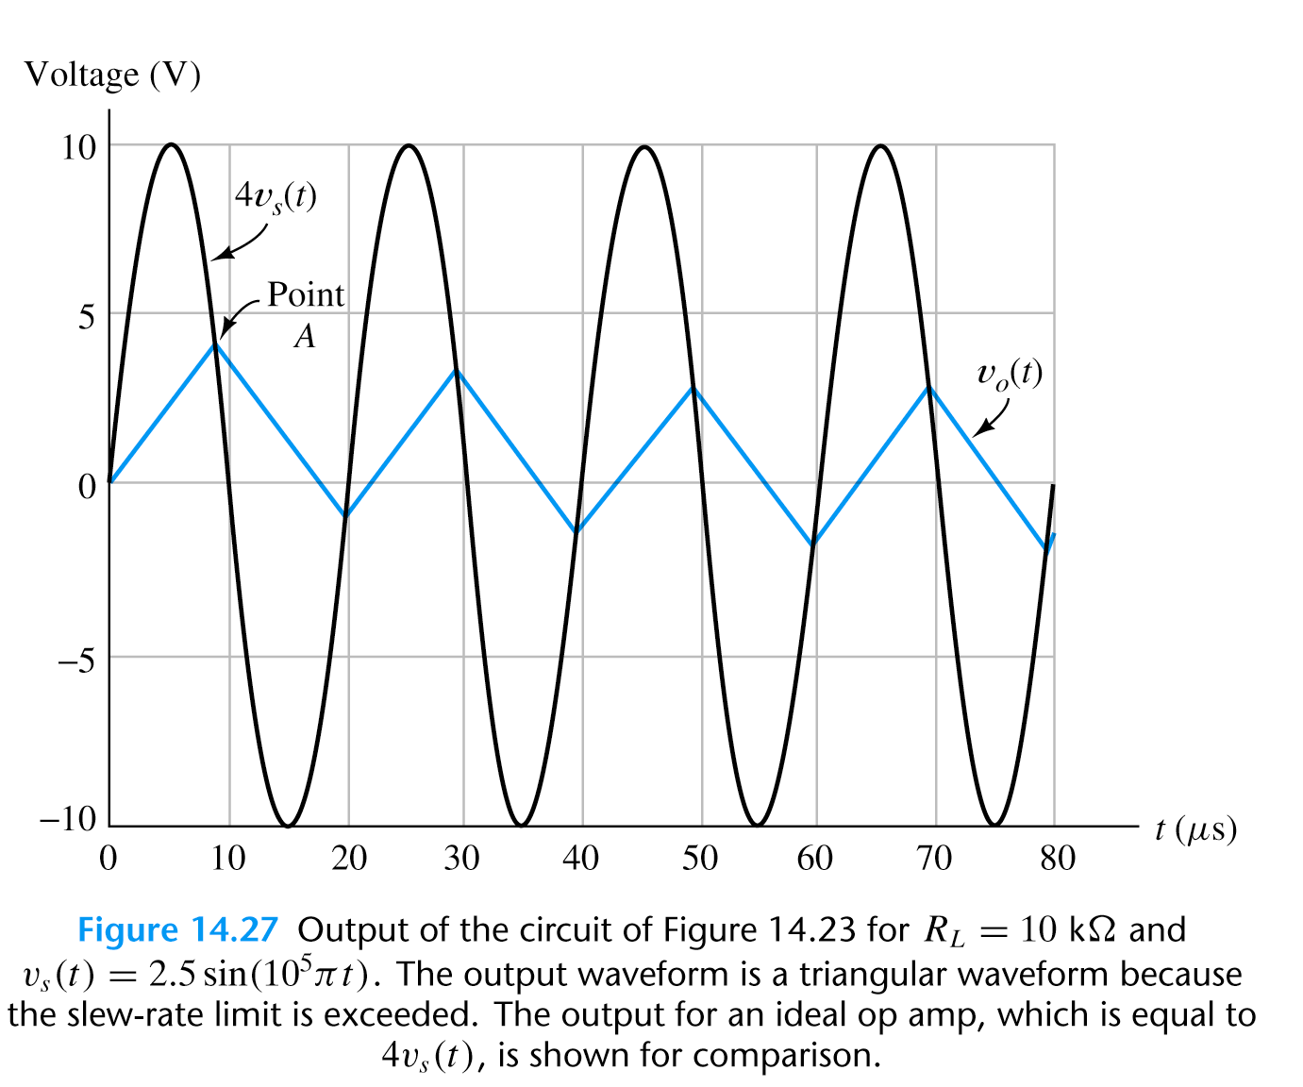
Nonlinear Limitations
Another nonlinear limitation is limited rate of change of the output signal known as the slew-rate limit SR
Using slew rate (SR), we can find maximum frequency known as full-power bandwidth.
Assuming:
So the full-power bandwidth
maximum frequency

Slide 38
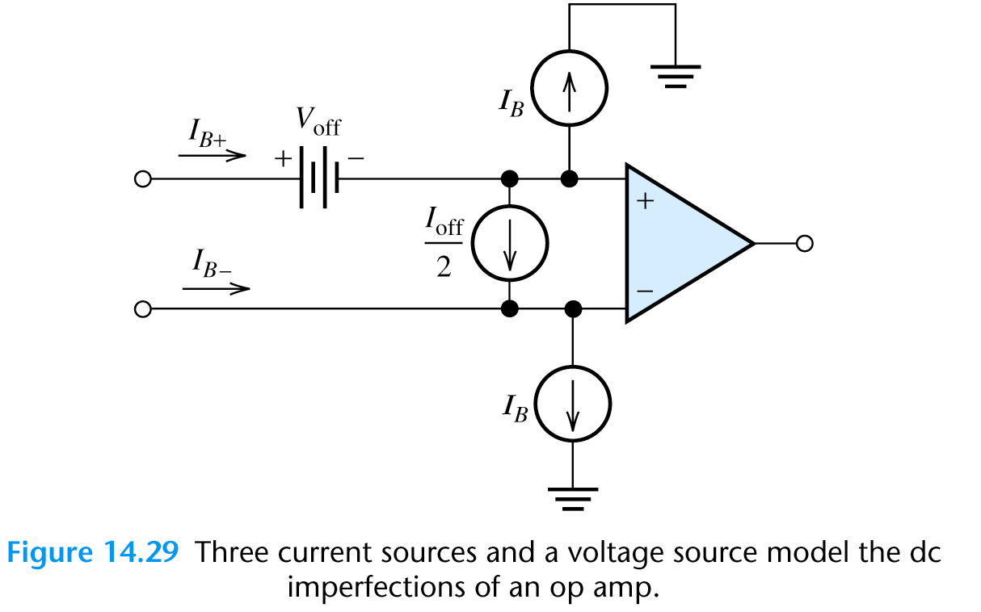
DC offset values
There are three DC offset values related to op-amp design:
Bias currents I_{B+}, I_{B-} – related to differential inputs
Offset current – ideally zero value
Offset voltage – results in nonzero output for zero input
They can be represented as additional DC sources in the
op-amp model
İdeal OPAMP

Slide 39
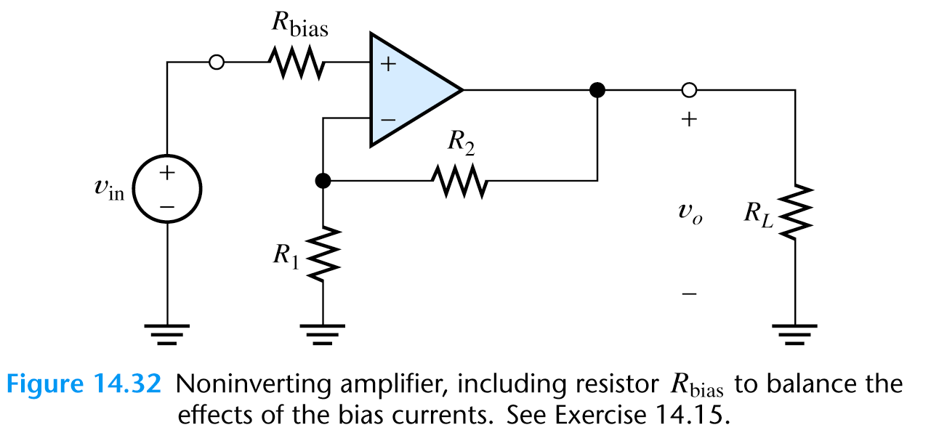
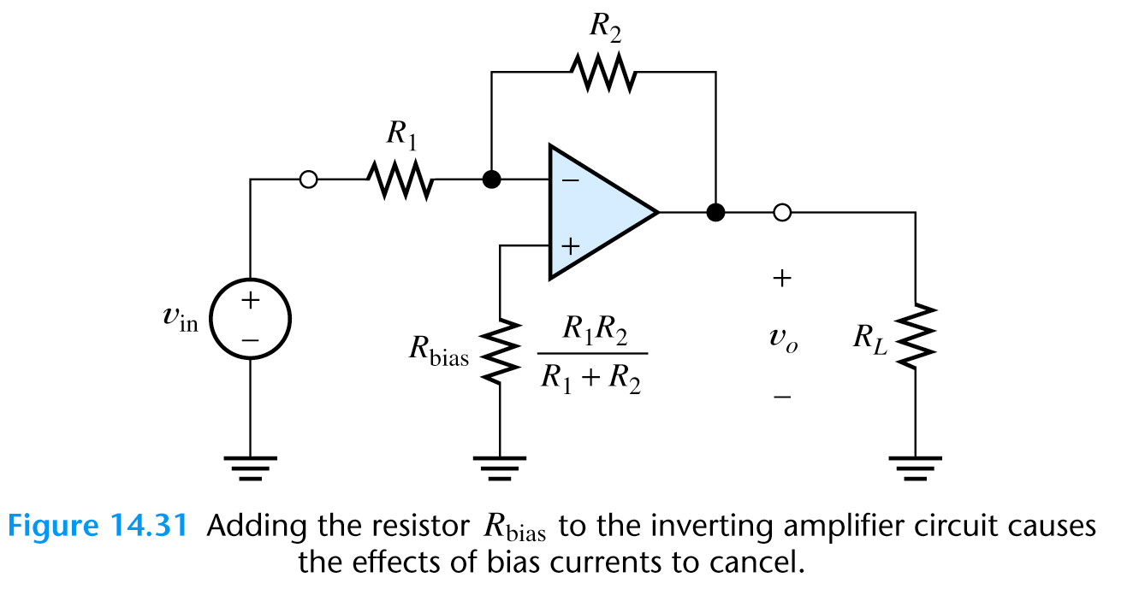
Resistor to balance the effect of bias currents

